Slide 1
ESA - FGD divisional Meeting Q1-2024 PFAS update

Slide 2
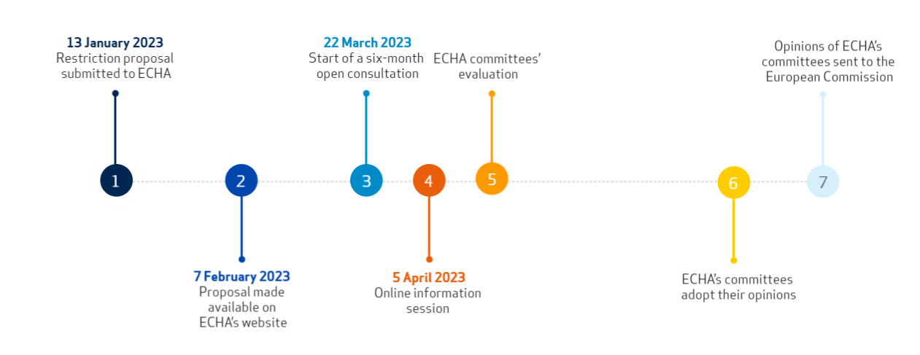
PFAS: Timeline „old & assumed new“
We are here
End of open public consultation 25th Nov.
Timeline „old“
With end of open public consultation and ECHA presenting opinion to EU
31.12.2023 ECHA presents opinion/proposal of bannning PFAS to EU
NO RETURN

Slide 3
PFAS: Timeline „old & assumed new“
We are here
End of open public consultation 25th Nov.
Timeline „old“
With end of open public consultation and ECHA presenting opinion to EU
31.12.2023 ECHA presents opinion/proposal of bannning PFAS to EU
NO RETURN
2030 (assumed) vote for acceptance
New open public consult. 2 month
Timeline „new“
Answering all participation letters
9month assumed by End of 2024
Evaluation and aswer
by Q1-Q2 2026
assumed: 13years derogation time for PTFE
(because of production substances and end of life cycle)
Release of interim proposal
by Q3-Q4 2026
Final proposal to EU (assumed Q4/2028)
8
9
Working in regulatory comitee by Q4 2027
Q1-Q2/2025 ECHA presents new proposal
assumed 2029 EU comission to decide if new proposal is OK followed by formal vote
all further timeline „assumed only“

Slide 4
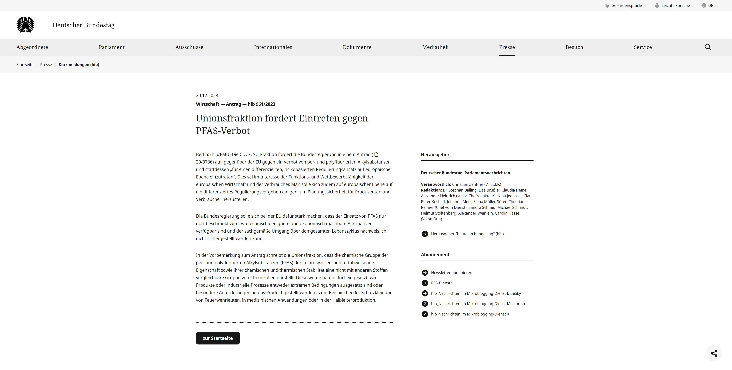
PFAS: Timeline „old & assumed new“
https://www.bundestag.de/presse/hib/kurzmeldungen-984336

