Slide 1
PFAS UPDATE PRESENTATION
ESA AGM Vienna
17/05/2022

Slide 2
PFAS Background
Based on Chemical Strategy the EU will phase out the use of PFAS in Europe, unless certain uses are proven essential to society. A group of countries (Germany, the Netherlands, Denmark, Sweden and Norway) have started a restriction project on PFAS chemicals including fluoropolymers. A consultation to gather evidence on the use, alternatives, emissions, and cost for replacement ran until 17 October 2021. ESA submitted feedback
In 2022 the five countries will make their restriction proposal to the European Chemical Agency (ECHA). ECHA will then launch a public consultation plus two internal reviews in its committee structure (RAC and SEAC). ECHA will then come forward with an opinion to the European Commission who then drafts a proposal, expected for 2024. A decision may not come into force however until 2025
An outright ban on PFAS will have a significant impact on products including sealing devices. It will be important to promote essential use cases to ensure ESA members’ products are exempt. According to CEFIC, almost 100 use cases for PFAS were missed by the member states, which suggests more research is needed in the use of PFAS before a restriction can take
Mark Neal/ Ralf Vogel, European Sealing Association

Slide 3
Aims of the ESA
PFAS Update Presentation
Get PTFE and other fluoropolymers as well as fluoroelastomers recognised as chemicals of less concern/essential use
Inform and lobby EU regulators in the interest of the sealing industry
Collect information about PFAS and make it available for all members
Cooperate with other trade organisations with similar interests
Mark Neal/ Ralf Vogel, European Sealing Association

Slide 4
Work to Date
PFAS Update Presentation
ESA established a PFAS Taskforce Group including members from all Divisions
ESA is linking with other concerned trade organisations (CEFIC, Plastics Europe, BPMA, VDMA, FSA)
A new ESA position statement was issued in March
A PFAS article by the ESA will be published in this month’s Valve World magazine
ESA participated in EU and UK consultations regarding PFAS and REACH
Mark Neal/ Ralf Vogel, European Sealing Association

Slide 5
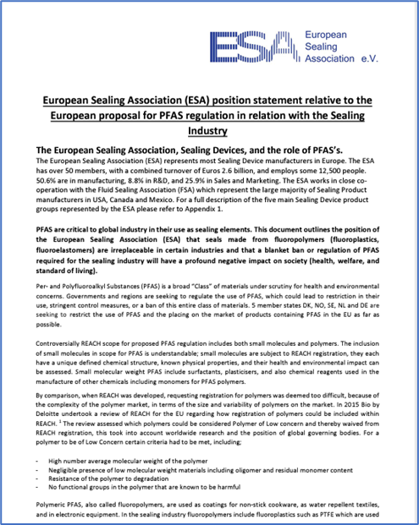
ESA PFAS Position Statement
PFAS Update Presentation
A new extensive ESA PFAS position statement was created by Mike Eason and Jean-Luc Matoux including case studies
It replaced the old statement from July 2020 and has been published on the ESA website
https://www.esaknowledgebase.com/wp-content/uploads/2022/03/ESA-Position-Statement-on-proposed-PFAS-regulation-March-2022-1.pdf
Mark Neal/ Ralf Vogel, European Sealing Association

Slide 6
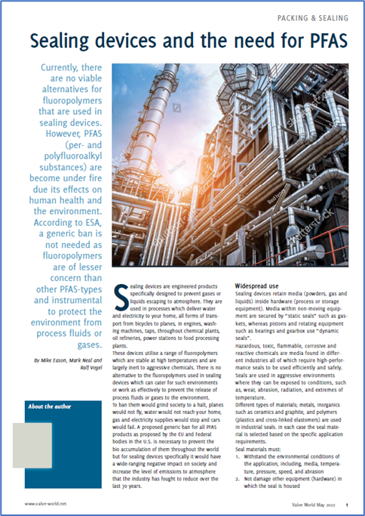
Article about PFAS
PFAS Update Presentation
Based on the new position statement an article about PFAS was created for publication in the May Edition of Valve World Magazine entitled “Sealing devices and the need for PFAS”
Mark Neal/ Ralf Vogel, European Sealing Association

Slide 7
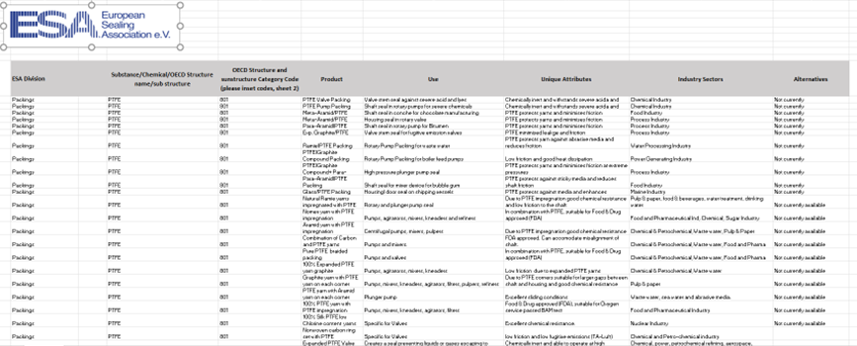
PFAS Spreadsheet
PFAS Update Presentation
The PFAS Taskforce in collaboration with the different Divisions developed a spreadsheet with references to PFAS chemicals used in sealing applications
The spreadsheet was submitted with the UK PFAS public consultation
It can be used by members to lobby their local authorities
Mark Neal/ Ralf Vogel, European Sealing Association

Slide 8
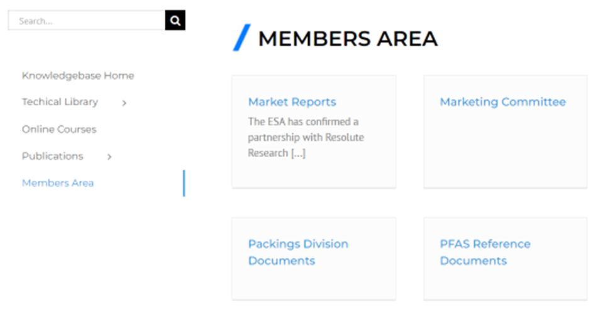
PFAS Reference Documents
PFAS Update Presentation
A Dropbox folder with all PFAS related documents has been set-up
Members can access a PFAS Reference Document Folder in the members area of the Knowledge Base
Mark Neal/ Ralf Vogel, European Sealing Association

Slide 9
CEFIC Information
PFAS Update Presentation
ESA joined the CEFIC PFAS collaboration platform group FPP4EU
Mark/ Ralf are attending the regular working group meetings
CEFIC collect case studies from industry to make a case for essential use PFAS
CEFIC developed a PFAS restriction decision tree map
The next face-to-face meeting will be in June in Brussels involving participation of EU legislators
CEFIC looking for the ESA to present case studies
Mark Neal/ Ralf Vogel, European Sealing Association

Slide 10
CEFIC PFAS Decision Tree
PFAS Update Presentation
Mark Neal/ Ralf Vogel, European Sealing Association

Slide 11
FSA PFAS Developments
PFAS Update Presentation
The FSA is very active to lobby regulators and the public regarding PFAS issues
A position statement and several magazine articles have been published
A PFAS webinar was broadcast in cooperation with the Hydraulic Institute - https://www.youtube.com/watch?v=baNlvKL_bZU
There are cases of PFAS litigation emerging in the US. These cases are mainly concerned with PFOA water contamination.
The FSA wants to educate people that not all PFAS’s are harmful
Mark Neal/ Ralf Vogel, European Sealing Association

Slide 12
Current EU Developments
PFAS Update Presentation
The EU Commission is seeking to develop a criteria for what are essential (or non-essential) uses of chemicals by the end of the year. This newly established criteria could have an impact on how and whether the various uses of fluoropolymers are restricted in the future
On 30 March, the European Commission announced an initiative on Persistent organic pollutants – perfluorohexane sulfonic acid (PFHxS). The public consultation is expected to open in Q2 2022
On 6 April, the European Chemical's Agency (ECHA) announced that, in collaboration with Member States, it has assessed a group of 148 bisphenols and recommended that 34 bisphenols need to be restricted due to their potential hormonal or reprotoxic effects
Mark Neal/ Ralf Vogel, European Sealing Association

Slide 13
Current US Developments
PFAS Update Presentation
The US Environmental Protection Agency (EPA) recently published its proposed budget for the fiscal year 2023. It provides approximately $126 million for EPA to increase its understanding of PFAS and prevent them from entering the air, land, and water. The proposed budget foresees an increase in funding for EPA's Drinking Water Programs (EPM and S&T), to address lead and emerging contaminants such as PFAS in drinking water
On 1 April the Environmental Protection Agency's (EPA) Science Advisory Board (SAB) announced two upcoming public meetings of its PFAS Review Panel. The two meetings, took place on 3 and 6 May, included a discussion on the analysis of cardiovascular disease risk reduction as a result of reduced PFOA and PFOS exposure in drinking water and a discussion on the proposed maximum contaminant level goal for PFOS in drinking water
Mark Neal/ Ralf Vogel, European Sealing Association

Slide 14
Future Work
PFAS Update Presentation
Collaborate further with other trade organisations
Publish opinion of ESA using different media
Lobby legislators in different EU member countries and in Brussels in cooperation with the Smiths Group
We need volunteers to present case studies to CEFIC and the EU in September
Mark Neal/ Ralf Vogel, European Sealing Association

Slide 15
THANK YOU Anybody who has further information on PFAS and/ or legislative developments please contact Mark or Ralf
European Sealing Association
310, Route de la Plagne,
Morzine, France, 74110
+33 (0)6 31 94 16 00
europeansealing.com

